Slide 1
K-Nearest Neighbors (KNN) classification

Slide 2
Birds of a feather flock together
It is also referred as “lazy learning”.
Nearest neighbor classifiers are defined by their characteristic of classifying unlabeled examples by assigning them the class of the most similar labeled examples.
OCRs
Movie recommendations
Detecting specific proteins in genetic data

Slide 3
Strengths
Simple and effective
Do not make any underlying distributional assumptions.
Fast training phase
Weaknesses
Does not produce a model, hence can’t provide insights in relationship among features.
Slow classification phase
Memory intensive
Nominal and missing data require additional processing.

Slide 4
Supervised or directed learning
Unlike k-means clustering, there is a target variable.
kNN identifies k records in the training data that are “nearest” in similarity.
k is defined in advance.
New record is assigned to the class of the majority of the k nearest neighbors.
kNN uses Euclidean distance by default.

Slide 5
k-interpretation and choice
For a given record, algorithm performs a vote among the k nearest neighbors. The given record is classified as the majority class among these neighbors.
Bias-variance tradeoff:
Small k can pick local patterns well
Large k is less sensitive to noisy data
typically value is [3,10]

Slide 6
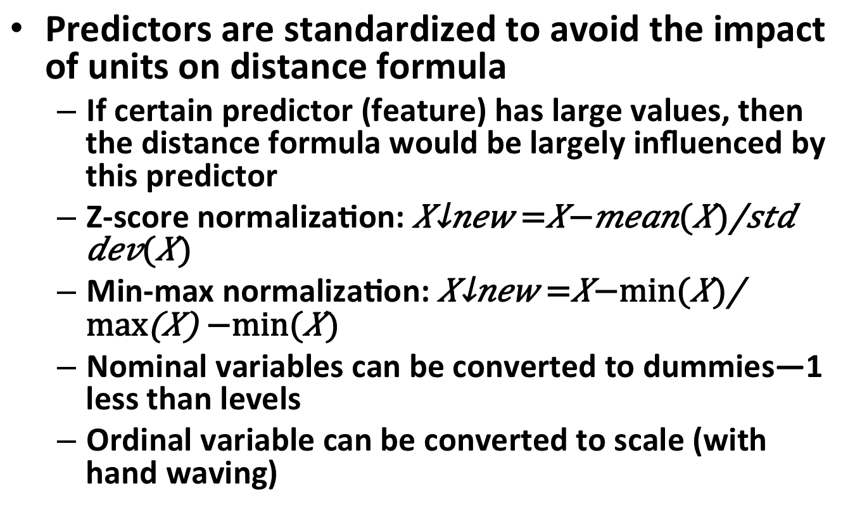
Standardize predictors
Predictors are standardized to avoid the impact of units on distance formula
If certain predictor (feature) has large values, then the distance formula would be largely influenced by this predictor
Z-score normalization:
Min-max normalization:
Nominal variables can be converted to dummies—1 less than levels
Ordinal variable can be converted to scale (with hand waving)

Slide 7
kNN (cntd.)
There is no model built
It is a non-parametric learning method
Fast training phase, but slow prediction phase
Due to heavy reliance on the training instances, it is also known as instance-based learning or rote learning

Slide 8
Class exercise
http://www.packtpub.com/code_download/13251
Download data and code from the above link. This is Ch3 from the book: “Machine learning with R”.
Data is Breast cancer biopsies data from 569 patients.
diagnosis is done based on 32 features. 30 of these 32 are scale variables, while 1 is an id, and the remaining one is diagnosis: M or B
30 measurements are mean, standard error and largest value for 10 characteristics
Open R-commander to upload the csv file from above.

Slide 9
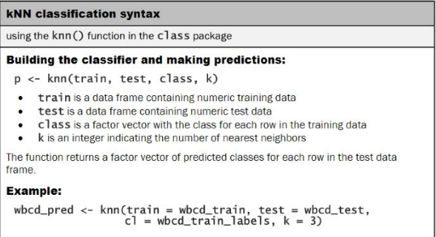
kNN classification syntax

Slide 10
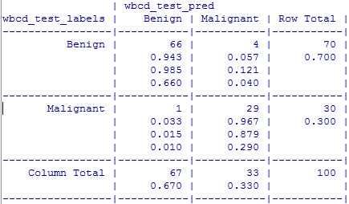
Evaluating model performance
Install.packages("gmodels")
Predicted
TN
FP
Specificity
Actual
Sensitivity
FN
TP
Precision (positive predictive value)

Slide 11
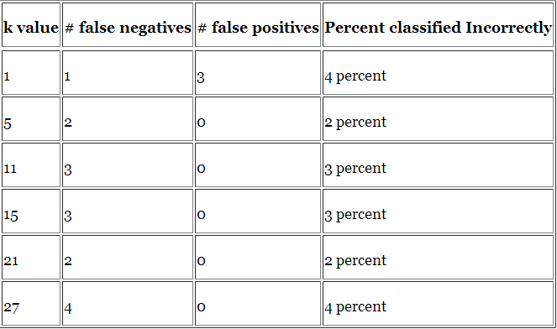
Model performance

